Slide 1

Data Visualization for Bird Strikes

Slide 2
Importance of Data Analysis
Data analysis is crucial in understanding the risks associated with bird strikes and developing effective prevention measures. By analyzing data on bird strikes, airports and airlines can identify high-risk areas and take proactive measures to prevent accidents.
Prevention Measures
Prevention measures for bird strikes include using bird-scaring devices, such as lasers and pyrotechnics, as well as modifying aircraft design to reduce the risk of bird strikes. Additionally, airports can implement bird-watching programs to monitor bird activity and adjust their prevention measures accordingly.
Bird strikes may occur during any phase of flight, but are most likely during the take-off, initial climb, approach and landing phases due to the greater numbers of birds in flight at lower levels. To have a closer look the following document visually depicts the data collected on Bird Strikes by FAA between 2000-2011.

Slide 3
Problem Identication
● Visuals Depicting the Number of Bird Strikes
● Yearly Analysis & Bird Strikes in the US
● Top 10 US Airlines in terms of having encountered bird strikes
● Airports with most incidents of bird strikes – Top 50
● Yearly Cost Incurred due to Bird Strikes:
● When do most bird strikes occur?
● Altitude of Aeroplan's at the time of strike
● Phase of flight at the time of the strike.
● Average Altitude of the Aeroplan's in different phases at the time of strike
● Effect of Bird Strikes & Impact on Flight
● Effect of Strike at Different Altitude
● Were Pilots Informed? & Prior Warning and Effect of Strike Relation

Slide 4
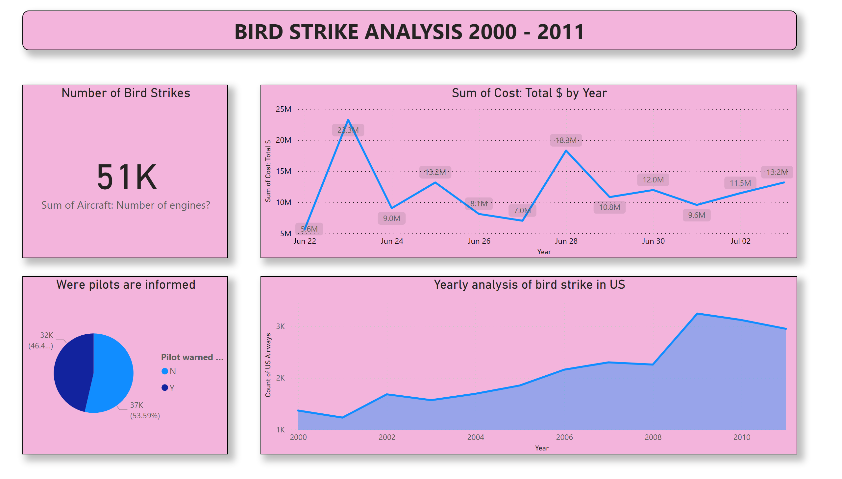
Page 1
Notes:
Number of Bird Strikes
No alt text provided
lineChart
No alt text provided
Were pilots are informed
No alt text provided
textbox
No alt text provided
Yearly analysis of bird strike in US
No alt text provided

Slide 5
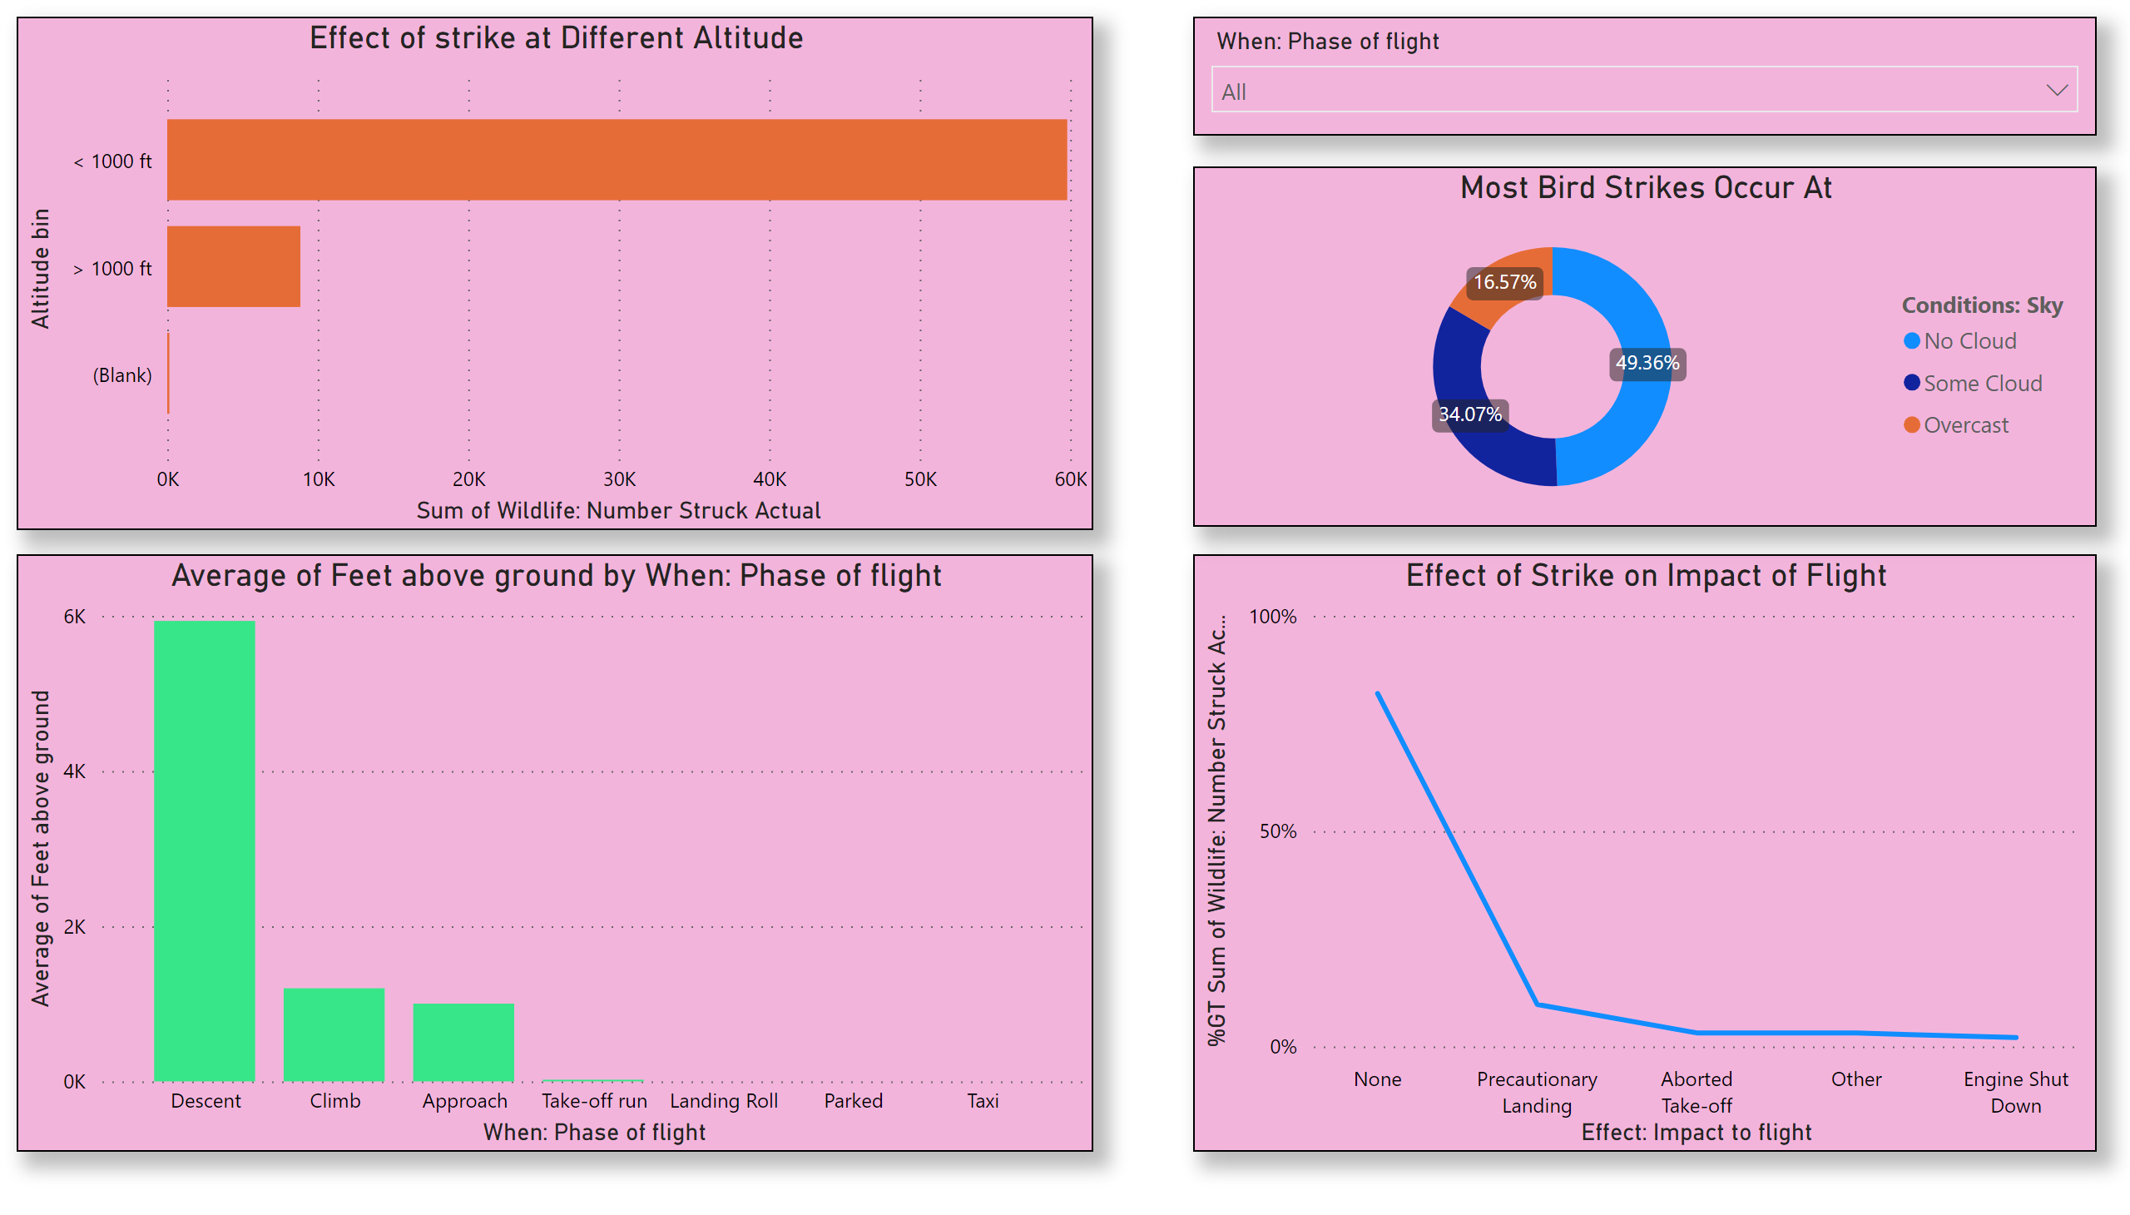
Page 2
Notes:
Effect of Strike on Impact of Flight
No alt text provided
Effect of strike at Different Altitude
No alt text provided
slicer
No alt text provided
clusteredColumnChart
No alt text provided
Most Bird Strikes Occur At
No alt text provided

Slide 6
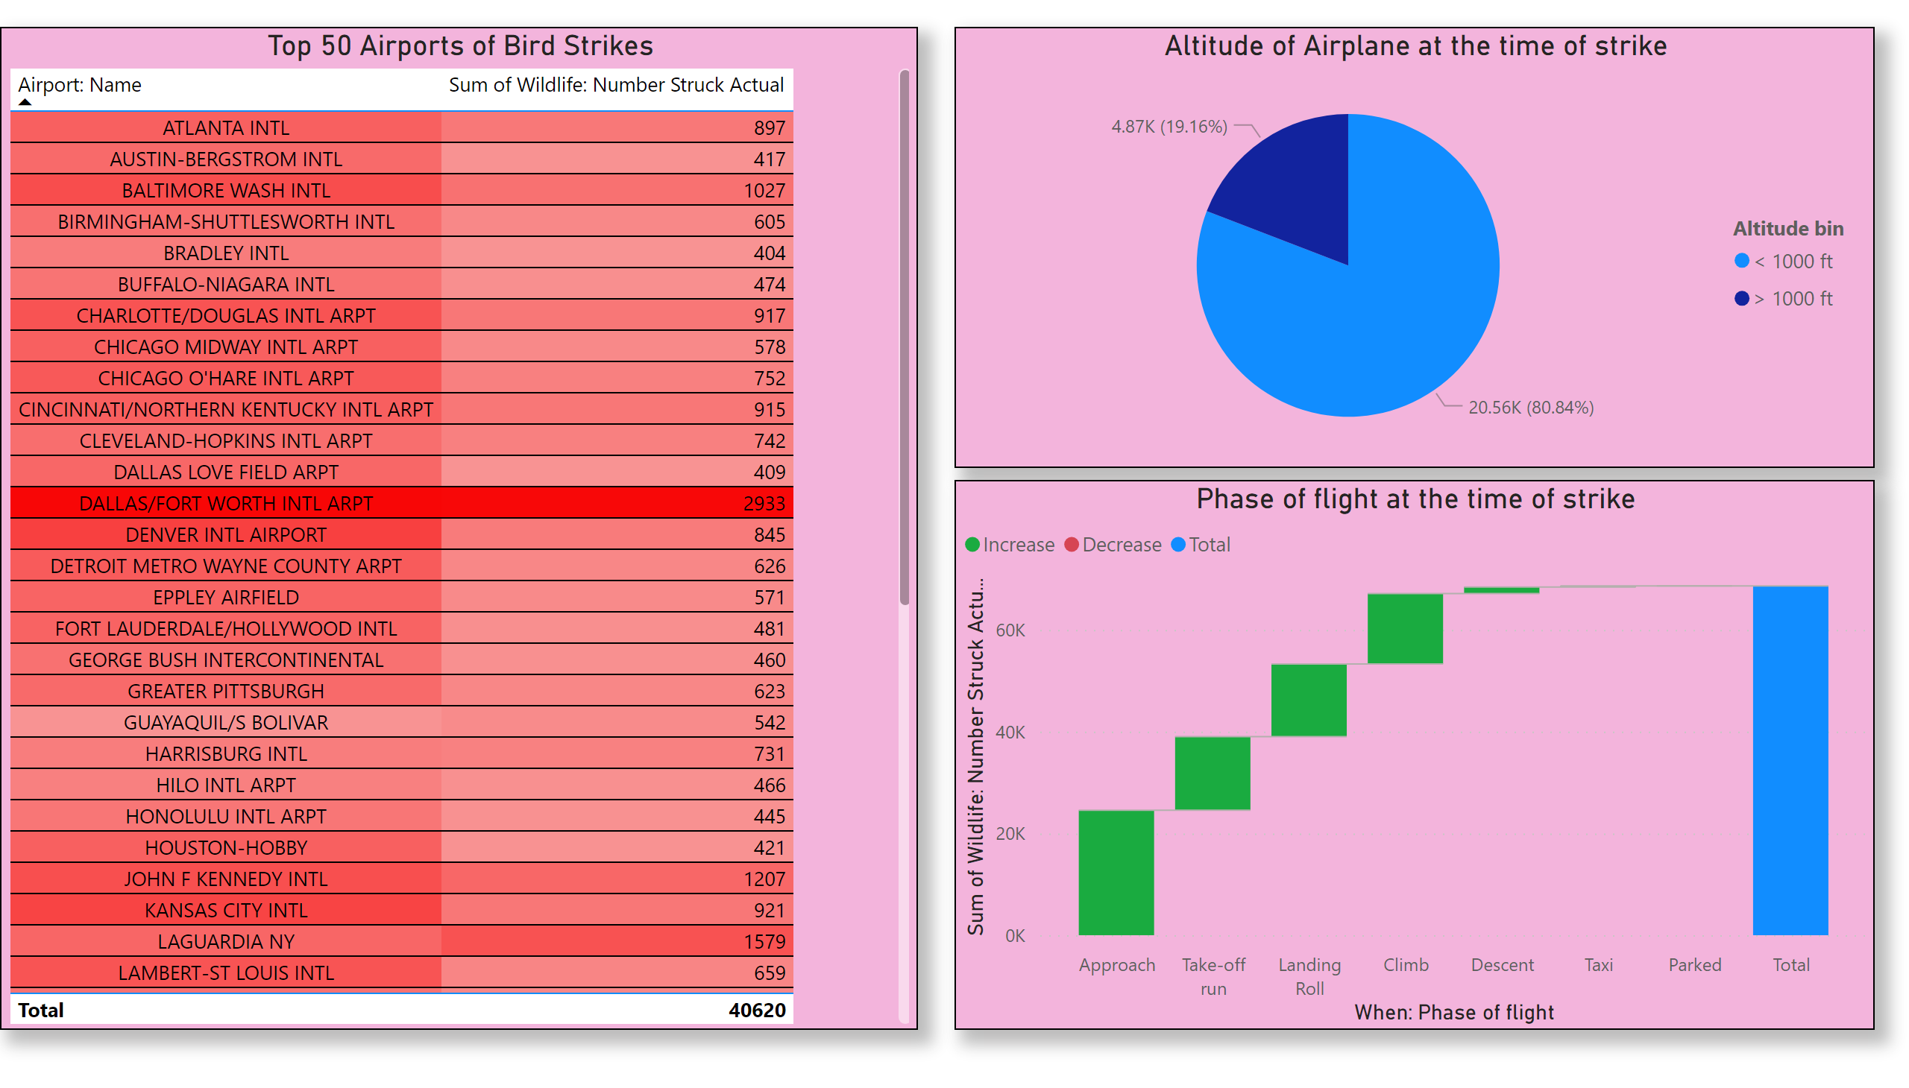
Page 3
Notes:
Top 50 Airports of Bird Strikes
No alt text provided
Altitude of Airplane at the time of strike
No alt text provided
Phase of flight at the time of strike
No alt text provided

Slide 7
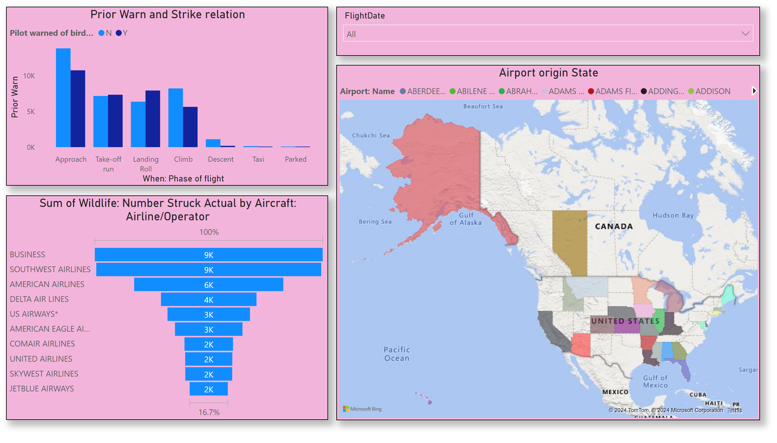
Page 4
Notes:
Prior Warn and Strike relation
No alt text provided
slicer
No alt text provided
Airport origin State
No alt text provided
funnel
No alt text provided

Slide 8
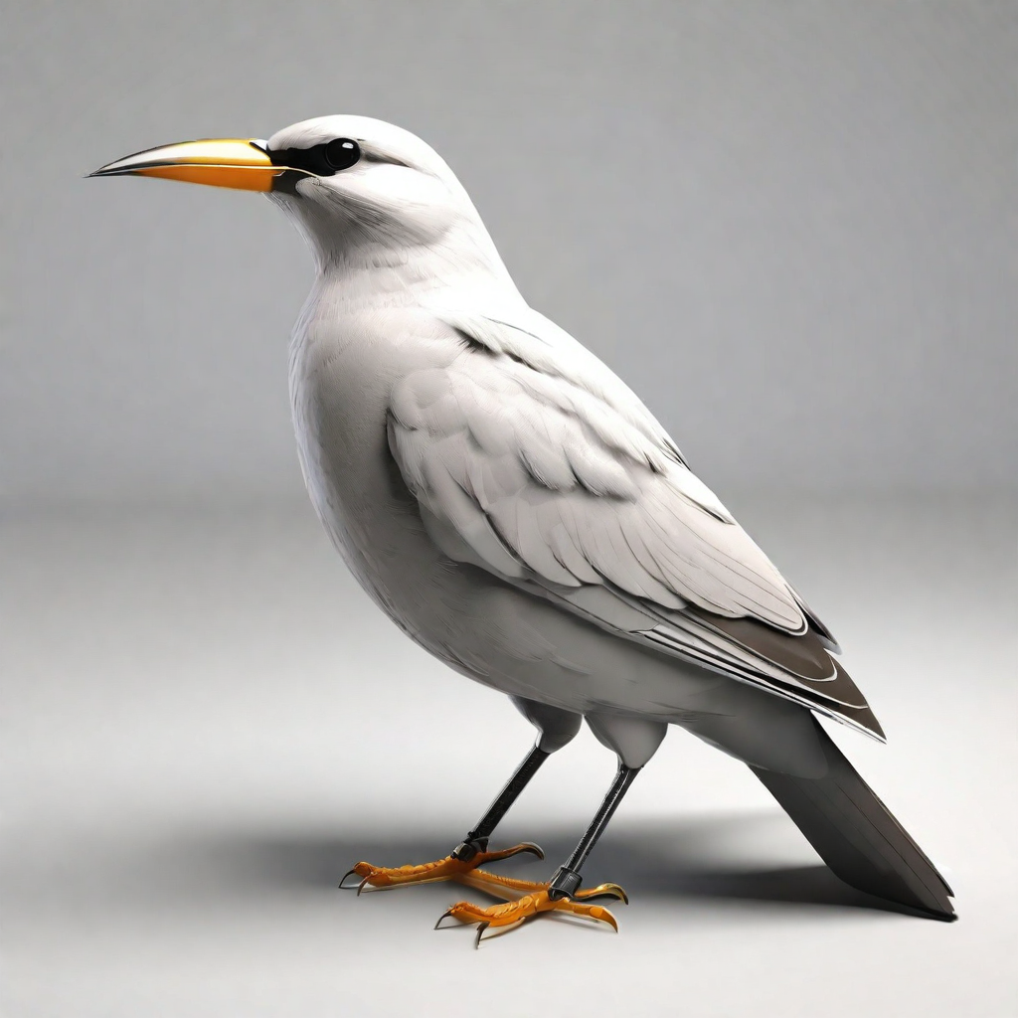
Thank you

